Slide 1
Slacking off
Make the most of workstream collaboration tools.
John Kealy, Web Services Manager

Slide 2
Slack makes communication more facile, creates a record for new lab members to search, cuts down email, and builds morale in our group.
Diana Laird
Associate Professor, Ob/Gyn, Reproductive Sciences

Slide 3
Slack channels streamline work where
disconnected email and text threads fall short.
The archived history of those channels document
processes and decision-making—
crucial in any scientific endeavor, but
especially in one as revolutionary as the Biohub
Joe DeRisi
Professor, Department of Biochemistry and Biophysics

Slide 4
My group uses Slack to communicate and everyone loves it!
Marina Sirota
Assistant Professor, Pediatrics

Slide 5
Current Slack Use at UCSF
Plan Type | Count of Teams | Number of Seats | Number of Guests
Free | 1,175 | 10,626 | 0
Plus annual | 2 | 68 | 12
Plus monthly | 1 | 9 | 0
Standard annual | 34 | 985 | 184
Standard monthly | 11 | 7,929 | 160
Grand Total | 1,223 | 19,617 | 356

Slide 6
Slack’s Business Impact
Surveys of Slack users indicate that Slack greatly improves their work experience:
Average of 48.6% reduction in email
24% drop in the number of meetings
32.4% increase in overall productivity
80% of users say Slack improved transparency and office culture

Slide 7
Current Risks and Issues
Slack is quickly becoming a UCSF standard, however:
There are no enterprise guidelines on usage or application support
Slack is not currently integrated with MyAccess
Lack of centralized visibility (governance) creates risks around UCSF private data
Data loss prevention and monitoring doesn’t exist in free versions or other non-enterprise versions
Lack of central management prevents UCSF from fully utilizing Slack as an enterprise communication and collaboration platform
Enterprise Slack is expensive
Yearly Cost: Standard ($80) Plus ($150) Enterprise (~$60)

Slide 8
What is workstream collaboration?
Workstream collaboration is a new way of working that leading organizations are increasingly adopting to get more done, more effectively, in less time.
Features
Persistent group chat as the primary user experience
Workspaces composed of channels
Direct messaging between individuals
File sharing
Search and discovery
Audioconferencing and videoconferencing
External guest access
Application library, plug-ins and bot frameworks
Platform services (e.g., administration, security, compliance, directory, API)

Slide 10
Other Workstream Collaboration Tools
Vendor | Website Link
Cisco | www.webex.com/products/teams/index.html
Flock | www.flock.com/
Google | www.gsuite.google.com/products/chat/
IBM | www.ibm.com/collaboration/collaboration-tools/watson-work/workspace
Mattermost | www.mattermost.com
Microsoft | www.products.office.com/en-us/microsoft-teams/group-chat-software
RingCentral | www.ringcentral.com/teams/overview.html
Slack | www.slack.com/
Symphony | www.symphony.com
Unify | www.Unify.com
Wire | www.wire.com/

Slide 11
Slack Enterprise Grid vs Microsoft Teams
Slack Enterprise Grid
Unlimited number of channel users
Extensive set of application integrations
Box
Zoom
Outlook, etc.
Cost: $57/person, annual
Microsoft Teams
5,000 person channel limit
Excellent integration with MS tools
SharePoint
OneDrive
Office 365 ProPlus
Cost: Free with Office 365

Slide 12
Why Do We Need a New Tool?
Collaborating over email is a disjointed and frustrating experience
Traditional messaging is lacking (Jabber, IRC, etc.)
Cloud applications allow for better integration of communications and work

Slide 13
Email: The Current Condition
Too much of it
Signal/noise ratio is low
CC lists can quickly become unwieldy
CC often used for CYA
Lack conciseness or brevity
Delayed responses
Once it’s sent, it’s gone
Can be forward to (unknown) others
Difficult to share information in old emails with others

Slide 14
Chat: The Current Condition
Traditional messaging is lacking (Jabber, IRC, etc.)
Conversations aren’t:
persistent
searchable
editable
Not widely adopted at UCSF
Not intelligent/configurable in notifications

Slide 15
The Opportunity of Cloud Applications
Persistent file sharing (vs. attachments) via Box
Messaging from monitoring applications to Slack
In-app audioconferencing and videoconferencing
Ability to add (and limit) external guest access
Extensible via application library, plug-ins, and bot frameworks

Slide 16
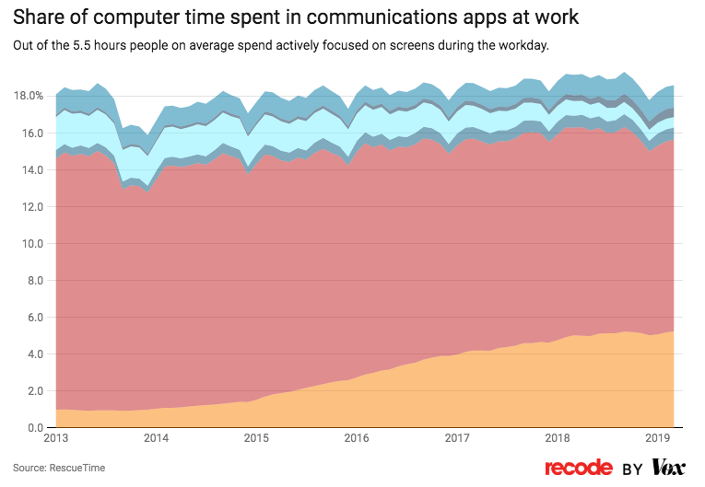
Notes:
Red is email
Orange is chat/messaging

Slide 17
Improving Employee Experience
Workstream software is good at:
Realtime collaboration
Reducing number of meetings
Building morale (the water cooler effect)
Conveying tone (emojis, gifs, help)
Quick Questions
Video calling (via Zoom)
Project management
Automating answers to common questions

Slide 18
Slack Basics
Sidebar
Chat window

Slide 19
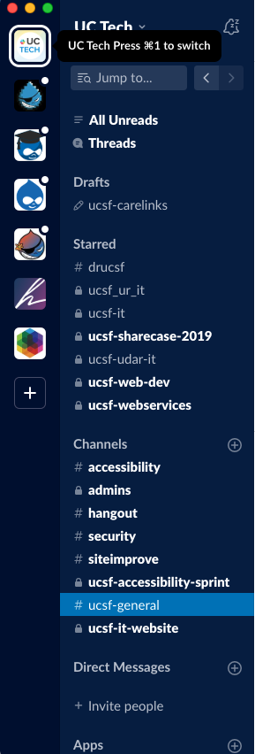
Slack Basics
Teams:
Teams are the basic bit of slack organization
Channels:
Channel are where most conversations occur are the basic bit of slack organization
Direct Messages:
1 to 1 or a small multi person chat.

Slide 20
Slack Best Practices
Slack is great for…
Urgent questions and requests that need a quick response
Real-time conversations
Asynchronous conversations
Sharing need-to-knows
Recognition of co-workers
Chatting and connecting with other channels
Sharing interesting links
Breaking down silos
Avoid Slack for…
High-level discussions. Use a meeting.
Making major decisions. Use a meeting.
Planning future work. Use a meeting and project management tools.
Requests that require significant work. Use project management tools.
Sharing in-depth knowledge or feedback. Use a meeting or email.

Slide 21
“Leave any channels that you don’t absolutely need to be in, and mute all notifications that don’t have you personally mentioned. If you absolutely need to concentrate for a period of time, say bye-bye to Slack by hitting command+Q.”
,
Saman Rahmanian
cofounder of Managed by Q

Slide 22
Top 10 Slack Best Practices
Download the app for the best experience
Change sidebar settings for better focus
Manage your notifications to avoid being always-on
Turn off sounds and animations
Leverage emojis for quick acknowledgement of message
Be judicious in your channel subscription
Be thoughtful about channel creation
Use the favorites system
Send yourself little notes or draft messages
Use notifications to foster conversation and participation

Slide 23
Slack Best Practices: Change Sidebar
Change sidebar settings to see only starred channels and unread messages.

Slide 25
Slack Best Practices
Manage your notifications to avoid being always-on…
…and set up do-not-disturb time.

Slide 26
Slack Best Practices: Turn Off Sounds
Go to Preferences > Notifications > Sound & appearance
Uncheck: play a sound when receiving a notification
Uncheck: play bounce Slack’s icon when receiving a notification

Slide 27
Best Practices: Emojis
Emojis let you react quickly and simply.

Slide 28
Slack Best Practices: Subscribing to Channels
Set different notification settings for different channels
Mute or leave channels that aren’t relevant to you
When creating a new channel, use a shared naming convention and include the purpose and topic
Change your “Mark as Read” settings to skip channel FOMO

Slide 29
Slack Best Practices: Creating Channels
Create a general channel in which everyone belongs
Create shared channels based on topic
Default to public channels when possible
Establish and maintain a standard naming convention
Each team should have its own channel to:
communicate work progress
share knowledge
solve problems
deliver quick status updates (sick, late, vacation, working from home etc.)
share a funny video, meme, etc.

Slide 31
Slack Best Practices: Favorites Starring
Keep track of important channels and messages by starring them
Star important channels, groups, and DMs to quickly access them
Star specific messages or files within a channel/group/DM to create a “follow up on” list
Change sidebar settings to only see starred channels and unread messages
Switch notifications to “only for highlighted words and direct messages”

Slide 32
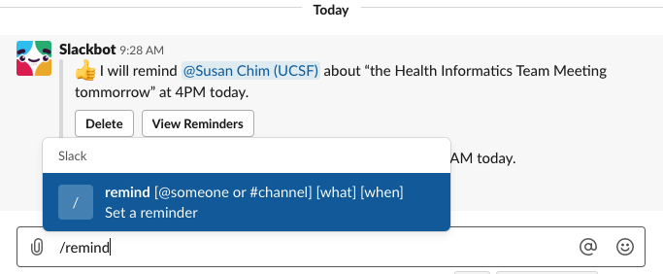
Slack Best Practices: Use reminders
/remind FTW!

Slide 33
Slack Best Practices: Notifications
Use notifications to foster conversation and participation
If you’re having a group conversation and want to add someone, then ping that person to join the conversation by using the @ symbol followed by her username.
This sends the person a notification and they can review the channel discussion before providing input.
You can use the @here shout to only notify members of the channel who are currently online.
You can also use similar calls, such as @everyone or @channel which notifies everyone in that channel, telling them that you have something important to say. This should be used rarely if at all. It’s equivalent to sending an email to everyone in the channel.

Slide 35
Resources
Workstream Collaboration: What It Is & Why You Need It https://mattermost.com/blog/why-workstream-collaboration/
Slack Enterprise Grid Versus Microsoft Teams — Which Workstream Collaboration Product Is Best for You? Garner Reports: Published 20 May 2019 - ID G00378256
Market Guide for Workstream Collaboration Garner Reports: Published 19 September 2018 - ID G00354158
How to set up Slack for Focus: A guide to killing unnecessary noise and distractions https://blog.rescuetime.com/slack-focus-guide#appearance
You’re not using Slack right — 10 tips to cut the noise https://www.manifold.co/blog/youre-not-using-slack-right-10-tips-to-cut-the-noise-6c4c25d89bfd
Best Practices From The Most Active Slack Users https://www.fastcompany.com/3046011/best-practices-from-the-most-active-slack-users

